Slide 1
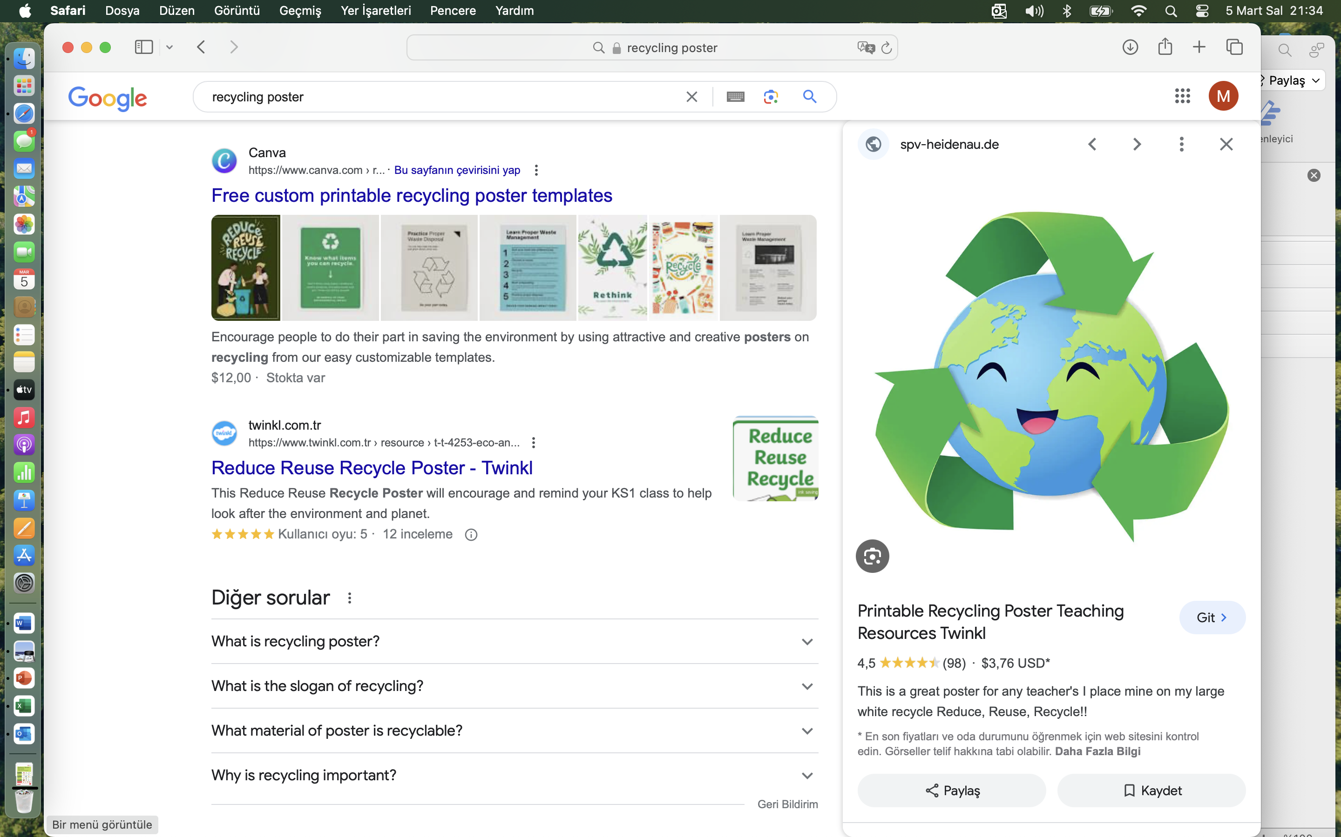


Recycling

Slide 2

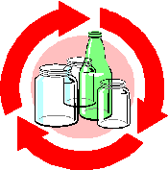
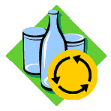
What is RECYCLING

Slide 3
Some of the waste we throw away can be recycled and reused. This is called
''RECYCLING''.

Slide 4








PLASTIC
PAPER
Plastic bottle
Paper cup
Bottle
GLASS
METAL
Can

Slide 5

REUSE
REDUCE
RECYCLE

Slide 6




REUSE
REDUCE
RECYCLE

Slide 7
Reduce means to minimise the amount of waste we create.
Reuse refers to using items more than once.
Recycle means putting a product to a new use instead of throwing it away.

Slide 8
For Example

Slide 9
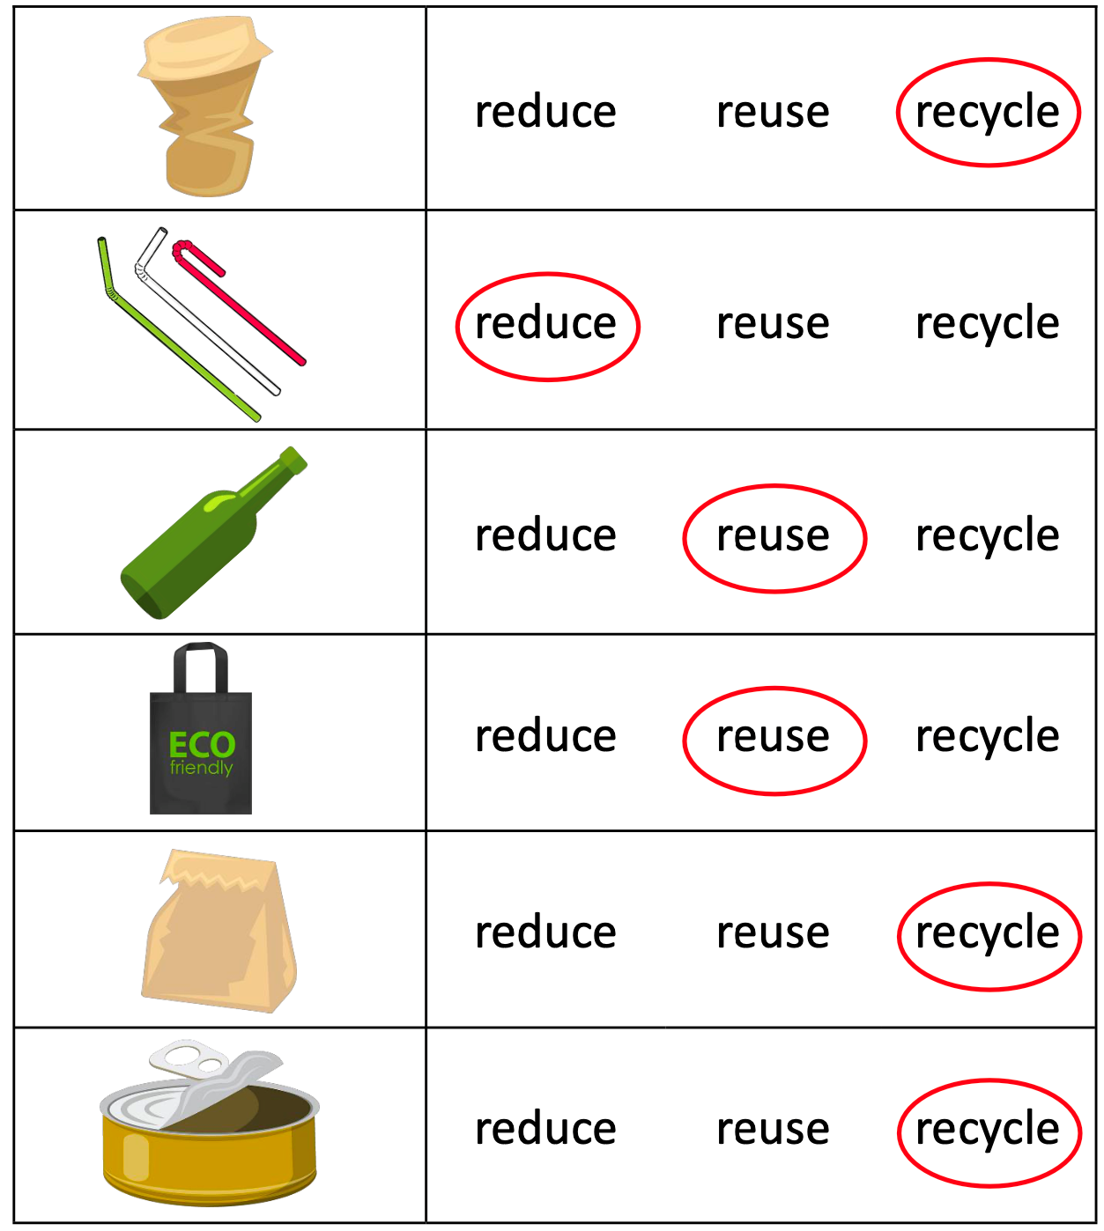
reduce
reuse
recycle
reduce
reuse
recycle
reduce
reuse
recycle
reduce
reuse
recycle
reduce
reuse
recycle
reduce
reuse
recycle

Slide 10


Slide 11





2022-1-BG01-KA220-SCH-000085065
School subject: Natural Science
Students’Age: 7 years
Topic: Recycling
Credits: Antalya Directorate Of Education
All media are within the EU intellectual property law.
The European Commission’s support for this publication does not constitute an endorsement of the contents, which reflect the views only of the authors, and the Commission cannot be held responsible for any use which may be made of the information contained herein.

